Slide 1
ONLINE VOTING SYSTEM BY USING FACIAL AUTHENTICATION
GUIDE NAME:
Dr. KALA R (Associate Professor\CSE)
STUDENT NAME:
KALAIMARAN M (20P220)
NARESH KUMAR S (20P230)
PAVAN KUMAR R (20P233)

Slide 2
1.ONLINE VOTING SYSTEM
What is an online voting system?
An online voting system is a software platform that allows groups to securely conduct votes and elections. High-quality online voting systems balance ballot security, accessibility, and the overall requirements of an organization's voting event.
You may hear an online voting system being referred to as an online election system, an online e voting system, or electronic voting. These all make reference to the same thing: a secure voting tool that allows your group to collect input from your group and closely scrutinize the results in real time.

Slide 3
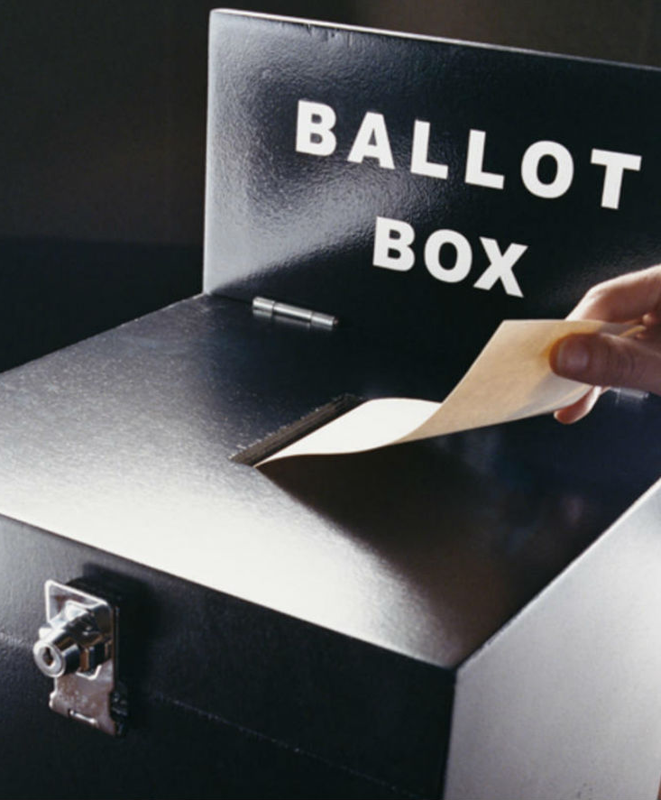
VOTING SYSTEM (THEN)
The voting system currently being used by the association is a paper based system, in which the voter simply picks up ballots sheets from electoral officials, tick off who they would like to vote for, and then cast their votes by merely handing over the ballot sheet back to electoral official.
The electoral officials gather all the votes being cast into a ballot box. At the end of the elections, he electoral officials converge and count the votes cast for each candidate and determine the winner of each election category.

Slide 4
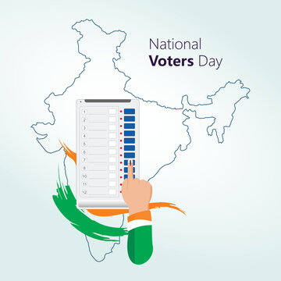
VOTING SYSTEM (NOW)
Electronic Voting Machine (also known as EVM) is voting using electronic means to either aid or take care of the chores of casting and counting votes.
An EVM is designed with two units: the control unit and the balloting unit. These units are joined together by a cable. The control unit of the EVM is kept with the presiding officer or the polling officer. The balloting unit is kept within the voting compartment for electors to cast their votes.

Slide 5

VOTING SYSTEM (UPCOMING)
Online Voting Software aims at making the voting process easy in any type of elections. Presently voting is performed using ballot paper and the counting is done manually, hence it consumes a lot of time. There can be possibility of invalid votes.
All these make election a tedious task. In recent times in India, due to elections the second wave of COVID transmission also made huge loss of human lives. In our proposed system voting and counting is done with the help of computer in Online.

Slide 6
2.EXISTING SYSTEM
In this system we use to go for the polling booth and we have to poll there in a paper ,and then it converted to Electronic Polling Machine till now we are using this method alone
By the help of "Investigation of E-voting system using face recognition using convolutional neural network (CNN)" This Paper Theoretical Computer Science (ELSEVIER)
This paper is useful to us to Upgrade the Existing system to online Mode ,In this paper they used Face recognition we have to Upgrade it to the future technology

Slide 7

3.METHADOLOGY
Facial recognition is the process of identifying or verifying a person's identity using their face. It captures, analyzes, and compares patterns based on the person's facial details.
The face detection process is an essential step in detecting and locating human faces in images and videos.
The face capture process transforms analog information (a face) into digital information (data or vectors) based on the person's facial features.
The face match process verifies if two faces belong to the same person.

Slide 8

4.PROPOSED SYSTEM
According to the paper “ Investigation of E-voting systems using face recognition using convolutional neural networks (CNN) (IEEE)“. CNN algorithm is the fastest algorithm compared to all other theories. But its accuracy rate is 77.0344%.It can cause the disaster of fake voting and to issues in voting.
In online voting system we also care to reduce the fake voting. In that case the idea to use the Viola-Jones algorithm which was introduced in 2001 by Paul Viola and Michael Jones and the accuracy rate of this algorithm is 97.41% to implement that and make the accurate voting system. This idea is to help to reduce the count of fake votes and to increase the voting count

Slide 9
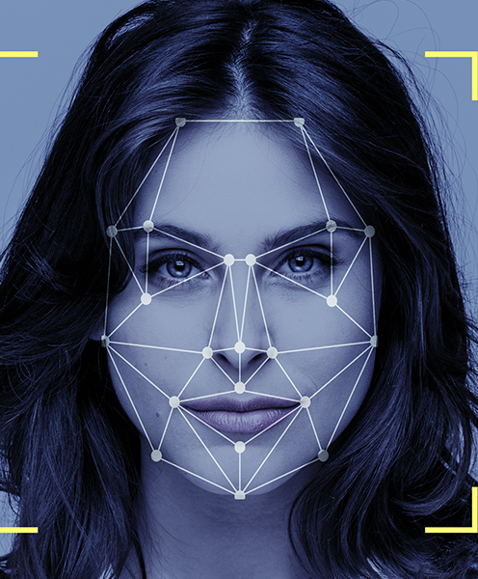
Viola-Jones algorithm
Viola-Jones algorithm is a machine-learning technique for object detection proposed in 2001 by Paul Viola and Michael Jones in their paper “Rapid object detection using a boosted cascade of simple features”.
The algorithm was primarily conceived for face detection. Viola-Jones algorithm is a machine-learning technique for object detection proposed in 2001 by Paul Viola and Michael Jones in their paper “Rapid object detection using a boosted cascade of simple features”. The algorithm was primarily conceived for face detection.

Slide 10

DETAILS OF VIOLA-JONES ALGORITHM
Given a grayscale image, the algorithm analyzes many windows of different sizes and positions and tries to detect the target object by looking for specific image features in each window.
The Viola-Jones algorithm is based on four main ideas, which we’ll discuss in the sections below:
Haar-like features
Integral images for accelerating the feature computation
AdaBoost learning for feature selection
Cascade of classifiers for fast rejection of windows without faces.

Slide 11

ADVANTAGES OF PROPOSED SYSTEM
The objective of the VOTING SOFTWARE is to provide better information for the users of this system easily they can vote from anywhere without facing any difficulty.
The proposed system does not require any physical presence during vote polling or counting. So it is very easy to conduct elections even during the pandemic situations without any spread of disease or human live losses.
The proposed system has good authentication so only authorized person can able to vote and also cannot vote multiple types.
Vote Counting can be made very quickly and results will be displayed in few minutes.

Slide 12
5.REFERENCE PAPERS
K. P. Kaliyamurthie, R. Udayakumar2, D. Parameswari and S. N. Mugunthan "Highly Secured Online Voting System" ,Indian Journal of Science and Technology
G. Revathy, K. Bhavana Raj , Anil Kumar, Spurthi Adibatti , Priyanka Dahiya , T.M. Latha ,"Investigation of E-voting system using face recognition using convolutional neural network (CNN)" , Theoretical Computer Science (ELSEVIER)
A Study on Smart Electronics Voting Machine Using Face Recognition and Aadhar Verification with IOT
Kone Srikrishnaswetha, Sandeep Kumar & Md. Rashid Mahmood, Part of the Lecture Notes in Networks and Systems book series (LNNS,volume 65)
T. Kohno, A. Stubblefield, A.D. Rubin, D.S. Wallach, Analysis of an electronic voting system , Publisher: IEEE June 2004
Himanshu Vinod Purandare; Akash Ramswaroop Saini; Freddy Donald Pereira; Bibin Mathew; Pratiksha S. Patil , "Application For Online Voting System Using Android Device" ,Publisher: IEEE January 2018

Slide 13
Hasan Piam, E. ., Mahmud, A., Abdulghafor, R., Wani, S., Abubakar Ibrahim, A., & Olowolayemo, A. (2022). Face Authentication-Based Online Voting System . International Journal on Perceptive and Cognitive Computing, 8(1), 19–23.
Germann, M., & Serdült, U. Internet Voting for Expatriates: The Swiss Case. JeDEM - EJournal of EDemocracy and Open Government. (2014).
Heiberg, S., & Willemson, J. Verifiable internet voting in Estonia. 2014 6th International Conference on Electronic Voting: Verifying the Vote - IEEE Proceedings EVOTE 2014, 1–8. (2015).
Lukas, S., Mitra, A. R., Desanti, R. I., & Krisnadi, D. Student attendance system in classroom using face recognition technique. 2016 International Conference on Information and Communication Technology Convergence, ICTC (2016).
Geitgey, A. (2010). face-recognition. https://pypi.org/project/face-recognition/.(2020).
Lin, W. H., Wang, P., & Tsai, C. F. Face recognition using support vector model classifier for user authentication. Electronic Commerce Research and Applications. (2016).

Slide 14
Lukas, S., Mitra, A. R., Desanti, R. I., & Krisnadi, D. Student attendance system in classroom using face recognition technique. 2016 International Conference on Information and Communication Technology Convergence, ICTC (2016).
Published in Image Processing On Line on 2014–06–26. Submitted on 2013–08–31, accepted on 2014–05–09. ISSN 2105–1232 c 2014 IPOL & the authors CC–BY–NC–SA This article is available online with supplementary materials, software, datasets and online demo at https://doi.org/10.5201/ipol.2014.104
P. Viola and M. J. Jones, Robust real-time face detection, International Journal of ComputerVision,57(2004),pp.137 154.http://dx.doi.org/10.1023/B:VISI.0000013087.49260.fb.
G. Tkacik, P. Garrigan, C. Ratliff, G. Mil ˇ cinski, J. M. Klein, L. H. Seyfarth, ˇ
P. Sterling, D. H. Brainard, and V. Balasubramanian, Natural images from the birth- place of the human eye, Public Library of Science One, 6 (2011), p. e20409.

Slide 15
Himanshu Agarwal G. N. Pandey Online voting system for India based on AADHAAR ID Publisher: IEEE
Ankit Anand , Pallavi Divya An Efficient Online Voting System International Journal of Modern Engineering Research (IJMER)
Shivendra Katiyar; Kullai Reddy Meka; Ferdous A. Barbhuiya; Sukumar Nandi Online Voting System Powered by Biometric Security Using Steganography Publisher: IEEE
S. Wolchok, E. Wustrow, D. Isabel, and J. A. Halderman. Attacking the Washington, D.C. Internet voting system. In 16th Intl. Conf. on Financial Cryptography and Data Security, FC, 2012.
L. von Ahn, B. Maurer, C. McMillen, D. Abraham, and M. Blum. reCAPTCHA: Human-based character recognition via web security measures. Science, 321(5895):1465–1468, 2008.
T.-F. Yen, Y. Xie, F. Yu, R. P. Yu, and M. Abadi. Host fingerprinting and tracking on the web: Privacy and security implications. In 19th Network and Distributed System Security Symposium, NDSS, 2012.

Slide 16
K. Zetter. Google hack attack was ultra sophisticated, new details show. Wired, Jan. 14, 2010. https://www.wired.com/ 2010/01/operation-aurora/.
R. L. Rivest. On the notion of ‘software independence’ in voting systems. Philosophical Transactions of the Royal Society A: Mathematical, Physical and Engineering Sciences, 366(1881):3759–3767, 2008.
D. G. Robinson and J. A. Halderman. Ethical issues in e-voting security analysis. In 2nd Workshop on Ethics in Computer Security Research, WECSR, 2011.
U.S. Election Assistance Commission Technical Guidelines Development Committee. Recommendations for requirements for the Voluntary Voting System Guidelines 2.0, Feb. 2020. https://www.eac.gov/sites/default/files/TestingCertification/ 2020_02_29_vvsg_2_draft_requirements.pdf.
U.S. Senate Select Committee on Intelligence. Russian active measure campaigns and interference in the 2016 U.S. election, Volume 1: Russian efforts against election infrastructure, 2019. https://www.intelligence.senate.gov/sites/default/files/ documents/Report_Volume1.pdf.

Slide 17
D. G. Robinson and J. A. Halderman. Ethical issues in e-voting security analysis. In 2nd Workshop on Ethics in Computer Security Research, WECSR, 2011
National Conference of State Legislatures. Electronic transmission of ballots, 2019. https://www.ncsl.org/research/ elections-and-campaigns/internet-voting.aspx.
NTIA Safety Working Group. “Early stage” coordinated vulnerability disclosure template, 2016. https://www.ntia.doc.gov/files/ntia/publications/ ntia_vuln_disclosure_early_stage_template.pdf.
U.S. Cybersecurity and Infrastructure Security Agency. Risk management for electronic ballot delivery, marking, and return (draft). Published by The Guardian, May 2020. https://www.scribd.com/document/460491458/CISAGuidelines-on-Internet-Voting.
U.S. Election Assistance Commission. A survey of Internet voting, 2011. https://www.eac.gov/sites/default/files/ eac_assets/1/28/SIV-FINAL.pdf.
M. Lindeman and P. B. Stark. A gentle introduction to risklimiting audits. IEEE Security & Privacy, 10(5):42–49, 2012

Slide 18

6.CONCLUSION
This online Voting system will manage the Voter’s information by which voter can login and use his voting rights. The system will incorporate all features of voting system.
This method of Voting System will be easier and user friendly too. Also it will reduce the fake voting.

Slide 19
THANK YOU

